Slide 1
clustering e-commerce customer

Slide 2
TABLE OF CONTENTS
01
02
03
Problem definition
Data Exploring + Data Preprocessing
Methodology
04
Results + Previous work

Slide 3
Introduction & Problem definiton
Our way of life has been transformed by e-commerce. We can now almost entirely order items online and have them delivered to our houses. E-commerce has become one of the fastest-growing business sectors at this time due to the acceleration caused by the global pandemic in 2020.
The data set we used provided us with a lot of relevant information. Even though some data scientists have already done customer clustering, there is still potential for improvement.

Slide 4
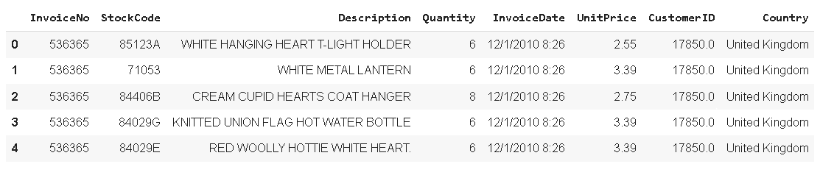
Data Used
Typically, e-commerce datasets are proprietary and consequently hard to find among publicly available data. However, The UCI Machine Learning Repository has made this dataset containing actual transactions from 2010 and 2011. The dataset is maintained on their site, where it can be found by the title "Online Retail".
This is a transnational data set which contains all the transactions occurring between 01/12/2010 and 09/12/2011 for a UK-based and registered non-store online retail. The company mainly sells unique all-occasion gifts. Many customers of the company are wholesalers.

Slide 5
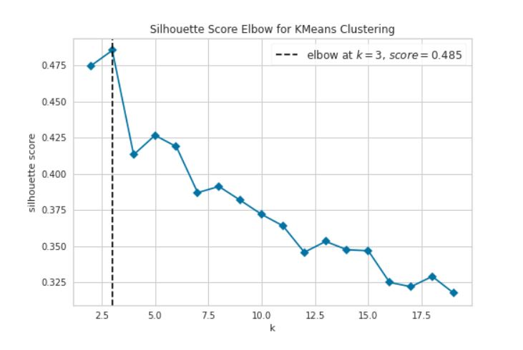
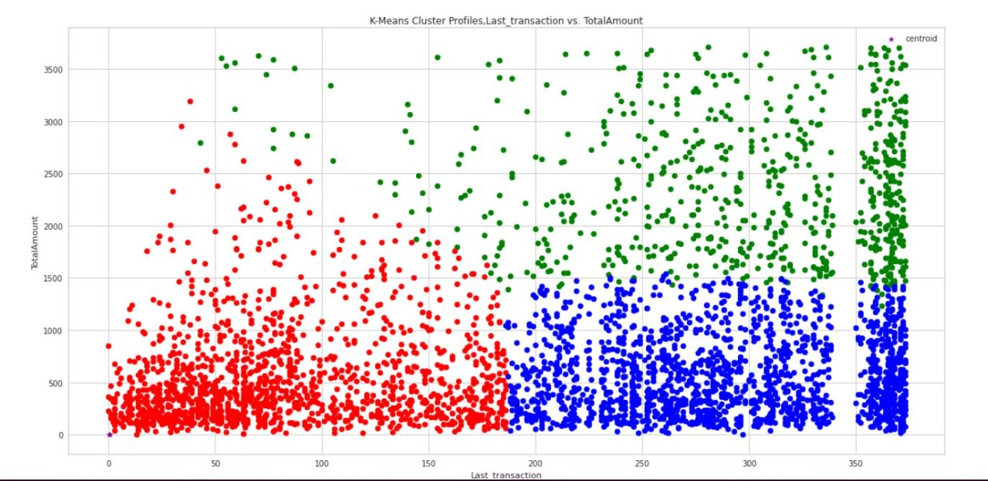
Previuos Work (K-means using Sillhouette method)

Slide 6
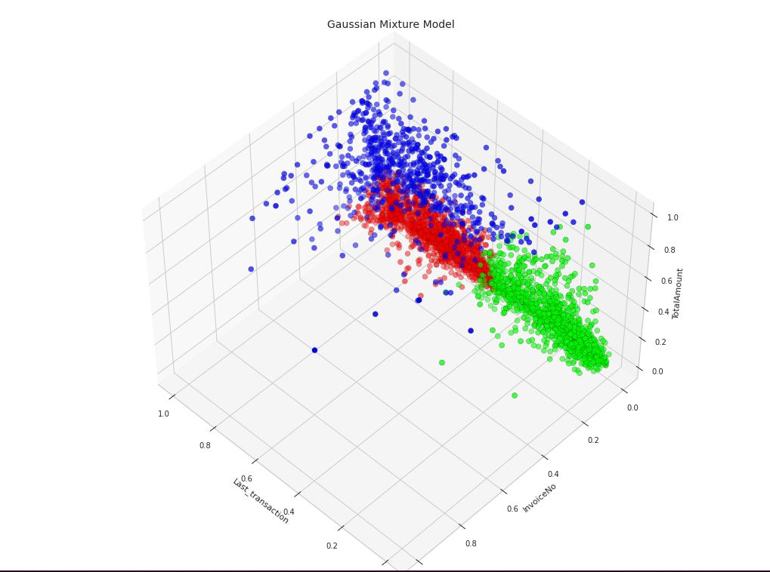
Previous Work (Gaussian Mixture)

Slide 7
Exploring the data
To understand more about the nature of our data, we will answer the fowling queries:
Which months had the highest sales
Products that are in the top 10 in sales and revenue
Products that were returned more frequently
Top 10 countries that purchased the most
How much is the share of the revenue for each manually clustered customer

Slide 8
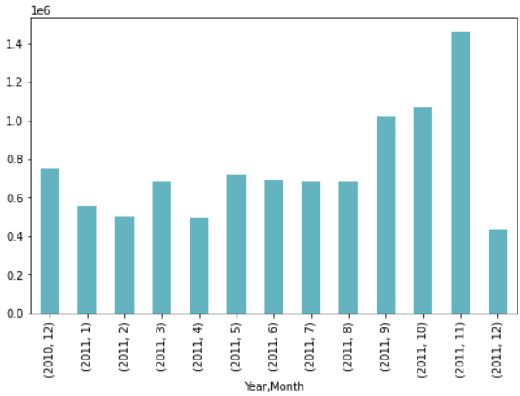
Months with the highest sales

Slide 9
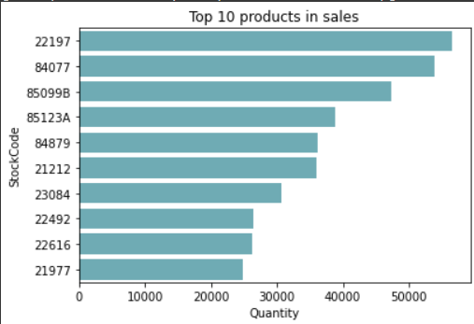
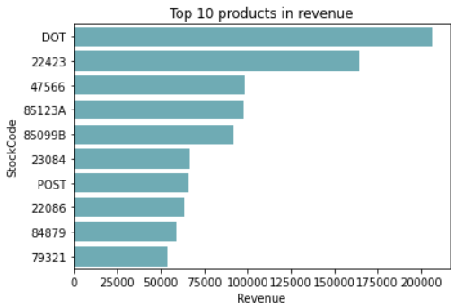
Products that are in the top 10 in sales and revenue

Slide 10
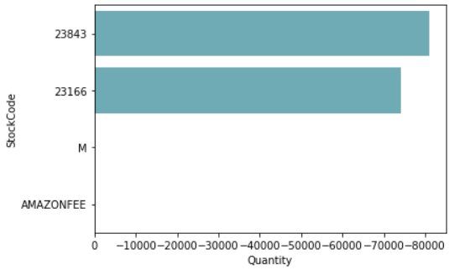
Products were returned more frequently

Slide 11
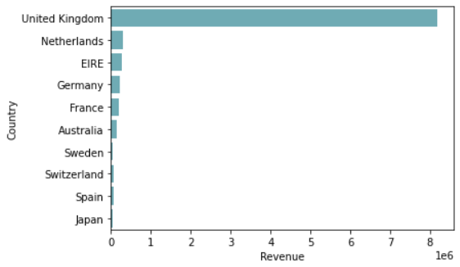
Most Consumed Country

Slide 12
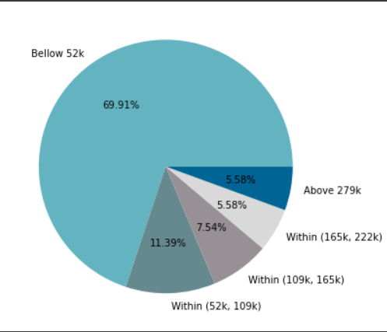
The share of the revenue for each manually clustered customer

Slide 13
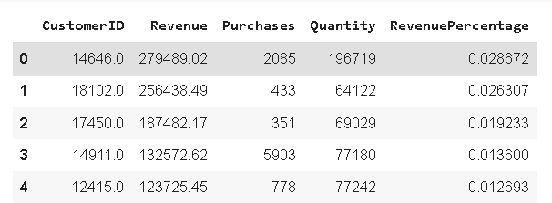
Data Preprocessing
We choose the revenue and number of purchases to cluster the customer.

Slide 14
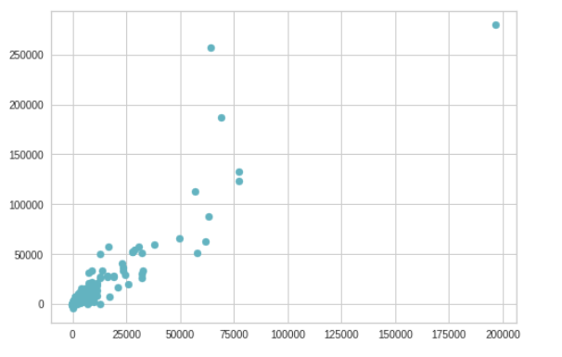
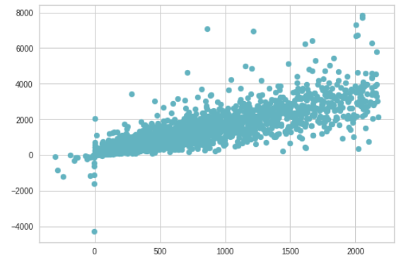
Data before and after removing the outliers

Slide 15
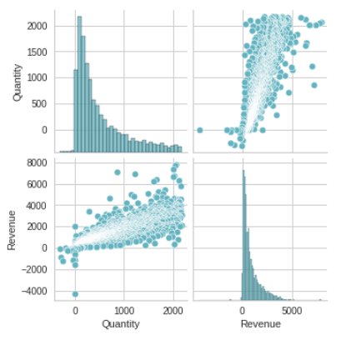
Correlation between the two selected features

Slide 16
Methdology
The data is split into test data and train data, and then scaled with minim maxim scaler
To analyze the data we used, we used two main clustering algorithms which are K-Means and Agglomerative Clustering. In both methods we determined optimal cluster number with Elbow method and Fitting each Model as well as Plotting the Result

Slide 17
K-Means
Agglomerative Clustering
It may be the most common used clustering algorithm and it includes allocating examples to clusters to reduce variance within each cluster.
The most popular type of hierarchical clustering, which the objects are grouped into clusters based on their similarity.

Slide 18
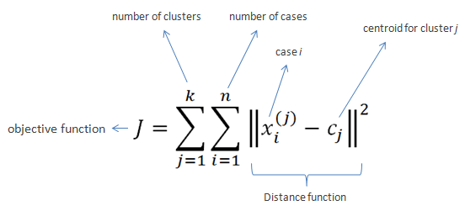
K-Means
We used cluster analysis or algorithm which is a common automatically discover natural grouping in data it is also can be helpful as a data analysis activity to learn more about the problem domain.

Slide 19
How it works?
Chose K as number of clusters
Chose random points as centroids (equal to k)
For each point in dataset,
Compute the distance between the point and every induvial centroid
Assign to the closest cluster based on minim distance
For each cluster, the new centroid is equal to the mean of its points
Repeat the process again until no points change cluster memberships

Slide 20
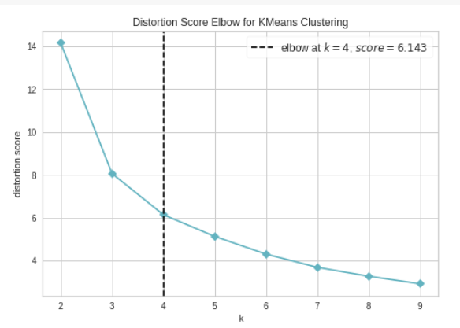
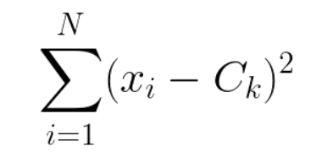
Applying Elbow method for K-Means
K-Means
K Means was employed a function from 2 to 9, this means that the experiment tested 8 candidates.
It can be obviously seen that the distortion score Elbow for K-Means clustering at k = 4 obtained the score of 6.143 as shown.

Slide 21
Results for K-Means

Slide 22
Voronoi Diagram & Clustering percentages for K-Means

Slide 23
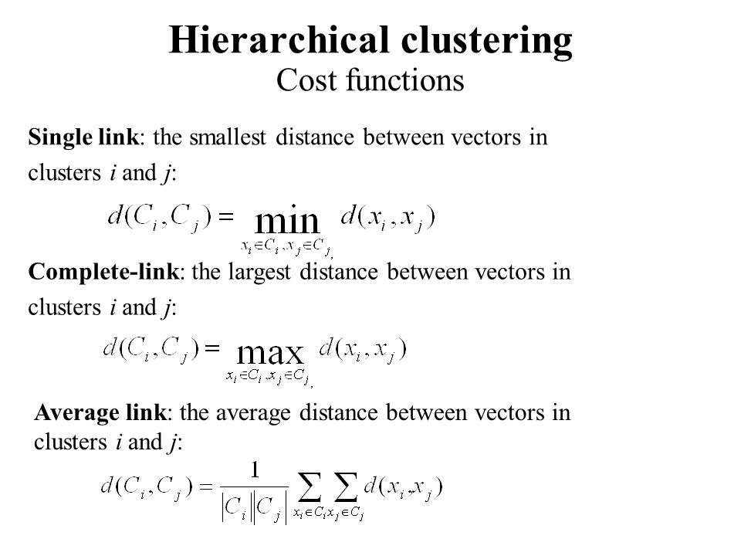
Agglomerative Clustering
A hierarchical clustering is a recursive partitioning of a data set into successively smaller clusters. It is represented by a rooted tree whose leaves correspond to the data points, and each of whose internal nodes represents the cluster of its descendant leaves

Slide 24
Applying Elbow method
Agglomerative Clustering
It can be obviously seen that the distortion score Elbow for K-Means clustering at k = 3 obtained the score of 19.102 as shown(train set).

Slide 25
Result for Agglomerative
After using the fitting formula, we must test the data through Agglomerative clustering as at k = 3 model. As shown:

Slide 26
Applying Elbow method
Agglomerative Clustering
It can be obviously seen that the distortion score Elbow for K-Means clustering at k = 4 obtained the score of 6.935 as shown.(test set)

Slide 27
Result for Agglomerative
It can be obviously seen that the distortion score Elbow for K-Means clustering at k = 4

Slide 28
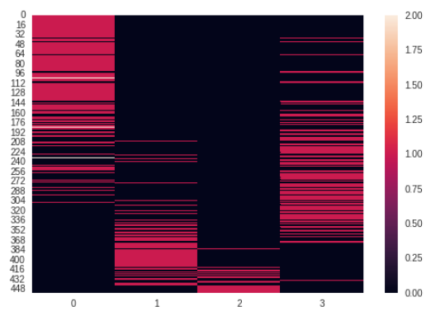

K-Means Evaluation
Compute completeness metric of a cluster labeling given a ground truth. A clustering result satisfies completeness if all the data points that are members of a given class are elements of the same cluster.
This metric is independent of the absolute values of the labels: a permutation of the class or cluster label values won’t change the score value in any way.
The Rand Index computes a similarity measure between two clustering by considering all pairs of samples and counting pairs that are assigned in the same or different clusters in the predicted and true clustering. The raw RI score is:
RI = (number of agreeing pairs) / (number of pairs)

Slide 29
THANKS

